Slide 1
Lecture 11 – Security and Dependability
Part 1

Slide 2
Topics covered
Dependability properties
The system attributes that lead to dependability.
Availability and reliability
Systems should be available to deliver service and perform as expected.
Safety
Systems should not behave in an unsafe way.
Security
Systems should protect themselves and their data from external interference.

Slide 3
System dependability
For many computer-based systems, the most important system property is the dependability of the system.
The dependability of a system reflects the user’s degree of trust in that system. It reflects the extent of the user’s confidence that it will operate as users expect and that it will not ‘fail’ in normal use.
Dependability covers the related systems attributes of reliability, availability and security. These are all inter-dependent.

Slide 4
Importance of dependability
System failures may have widespread effects with large numbers of people affected by the failure.
Systems that are not dependable and are unreliable, unsafe or insecure may be rejected by their users.
The costs of system failure may be very high if the failure leads to economic losses or physical damage.
Undependable systems may cause information loss with a high consequent recovery cost.

Slide 5
Causes of failure
Hardware failure
Hardware fails because of design and manufacturing errors or because components have reached the end of their natural life.
Software failure
Software fails due to errors in its specification, design or implementation.
Operational failure
Human operators make mistakes. Now perhaps the largest single cause of system failures in socio-technical systems.

Slide 6
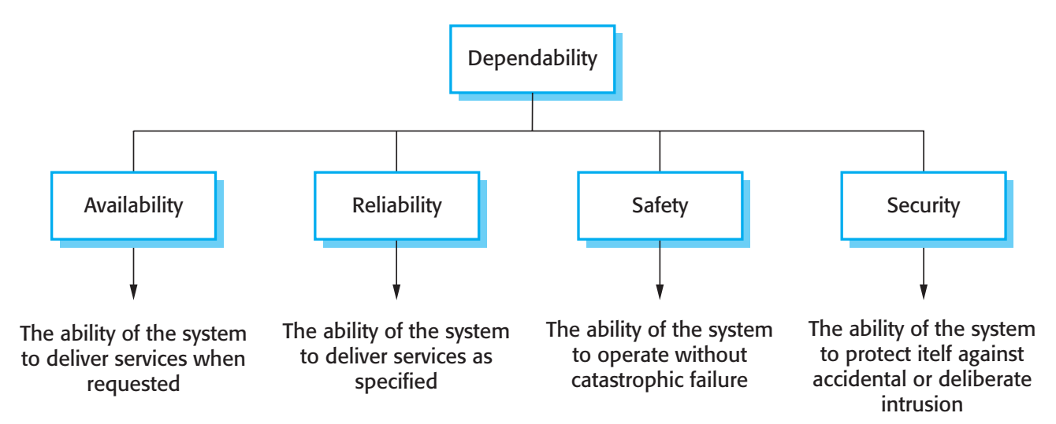
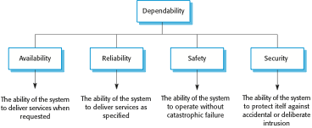
Principal dependability properties

Slide 7
Principal properties
Availability
The probability that the system will be up and running and able to deliver useful services to users.
Reliability
The probability that the system will correctly deliver services as expected by users.
Safety
A judgment of how likely it is that the system will cause damage to people or its environment.
Security
A judgment of how likely it is that the system can resist accidental or deliberate intrusions.

Slide 8
Other dependability properties
Repairability
Reflects the extent to which the system can be repaired in the event of a failure
Maintainability
Reflects the extent to which the system can be adapted to new requirements;
Survivability
Reflects the extent to which the system can deliver services whilst under hostile attack;
Error tolerance
Reflects the extent to which user input errors can be avoided and tolerated.

Slide 9
Repairability
The disruption caused by system failure can be minimized if the system can be repaired quickly.
This requires problem diagnosis, access to the failed component(s) and making changes to fix the problems.
Repairability is a judgment of how easy it is to repair the software to correct the faults that led to a system failure.
Repairability is affected by the operating environment so is hard to assess before system deployment.

Slide 10
Maintainability
A system attribute that is concerned with the ease of repairing the system after a failure has been discovered or changing the system to include new features.
Reparability – short-term perspective to get the system back into service; Maintainability – long-term perspective.
Very important for critical systems as faults are often introduced into a system because of maintenance problems. If a system is maintainable, there is a lower probability that these faults will be introduced or undetected.

Slide 11
Survivability
The ability of a system to continue to deliver its services to users in the face of deliberate or accidental attack
This is an increasingly important attribute for distributed systems whose security can be compromised
Survivability subsumes the notion of resilience - the ability of a system to continue in operation in spite of component failures

Slide 12
Error tolerance
Part of a more general usability property and reflects the extent to which user errors are avoided, detected or tolerated.
User errors should, as far as possible, be detected and corrected automatically and should not be passed on to the system and cause failures.

Slide 13
Dependability attribute dependencies
Safe system operation depends on the system being available and operating reliably.
A system may be unreliable because its data has been corrupted by an external attack.
Denial of service attacks on a system are intended to make it unavailable.
If a system is infected with a virus, you cannot be confident in its reliability or safety.

Slide 14
Dependability achievement
Avoid the introduction of accidental errors when developing the system.
Design V & V processes that are effective in discovering residual errors in the system.
Design protection mechanisms that guard against external attacks.
Configure the system correctly for its operating environment.
Include recovery mechanisms to help restore normal system service after a failure.

Slide 15
Dependability costs
Dependability costs tend to increase exponentially as increasing levels of dependability are required.
There are two reasons for this
The use of more expensive development techniques and hardware that are required to achieve the higher levels of dependability.
The increased testing and system validation that is required to convince the system client and regulators that the required levels of dependability have been achieved.

Slide 16
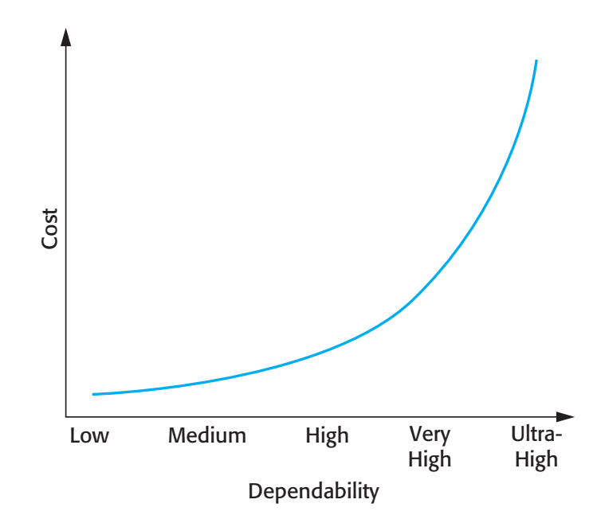
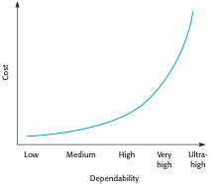
Cost/dependability curve

Slide 17
Dependability economics
Because of very high costs of dependability achievement, it may be more cost effective to accept untrustworthy systems and pay for failure costs
However, this depends on social and political factors. A reputation for products that can’t be trusted may lose future business
Depends on system type - for business systems in particular, modest levels of dependability may be adequate

Slide 18
Availability and reliability
Reliability
The probability of failure-free system operation over a specified time in a given environment for a given purpose
Availability
The probability that a system, at a point in time, will be operational and able to deliver the requested services
Both of these attributes can be expressed quantitatively e.g. availability of 0.999 means that the system is up and running for 99.9% of the time.

Slide 19
Availability and reliability
It is sometimes possible to subsume system availability under system reliability
Obviously if a system is unavailable it is not delivering the specified system services.
However, it is possible to have systems with low reliability that must be available.
So long as system failures can be repaired quickly and does not damage data, some system failures may not be a problem.
Availability is therefore best considered as a separate attribute reflecting whether or not the system can deliver its services.
Availability takes repair time into account, if the system has to be taken out of service to repair faults.

Slide 20
Perceptions of reliability
The formal definition of reliability does not always reflect the user’s perception of a system’s reliability
The assumptions that are made about the environment where a system will be used may be incorrect
Usage of a system in an office environment is likely to be quite different from usage of the same system in a university environment
The consequences of system failures affects the perception of reliability
Unreliable windscreen wipers in a car may be irrelevant in a dry climate
Failures that have serious consequences (such as an engine breakdown in a car) are given greater weight by users than failures that are inconvenient

Slide 21
Reliability and specifications
Reliability can only be defined formally with respect to a system specification i.e. a failure is a deviation from a specification.
However, many specifications are incomplete or incorrect – hence, a system that conforms to its specification may ‘fail’ from the perspective of system users.
Furthermore, users don’t read specifications so don’t know how the system is supposed to behave.
Therefore perceived reliability is more important in practice.

Slide 22
Availability perception
Availability is usually expressed as a percentage of the time that the system is available to deliver services e.g. 99.95%.
However, this does not take into account two factors:
The number of users affected by the service outage. Loss of service in the middle of the night is less important for many systems than loss of service during peak usage periods.
The length of the outage. The longer the outage, the more the disruption. Several short outages are less likely to be disruptive than 1 long outage. Long repair times are a particular problem.

Slide 23
Key points
The dependability in a system reflects the user’s trust in that system.
Dependability is a term used to describe a set of related ‘non-functional’ system attributes – availability, reliability, safety and security.
The availability of a system is the probability that it will be available to deliver services when requested.
The reliability of a system is the probability that system services will be delivered as specified.

Slide 24
Lecture 11 – Security and Dependability
Part 2

Slide 25
Reliability terminology
Term | Description
Human error or mistake | Human behavior that results in the introduction of faults into a system. For example, in the wilderness weather system, a programmer might decide that the way to compute the time for the next transmission is to add 1 hour to the current time. This works except when the transmission time is between 23.00 and midnight (midnight is 00.00 in the 24-hour clock).
System fault | A characteristic of a software system that can lead to a system error. The fault is the inclusion of the code to add 1 hour to the time of the last transmission, without a check if the time is greater than or equal to 23.00.
System error | An erroneous system state that can lead to system behavior that is unexpected by system users. The value of transmission time is set incorrectly (to 24.XX rather than 00.XX) when the faulty code is executed.
System failure | An event that occurs at some point in time when the system does not deliver a service as expected by its users. No weather data is transmitted because the time is invalid.

Slide 26
Faults and failures
Failures are a usually a result of system errors that are derived from faults in the system
However, faults do not necessarily result in system errors
The erroneous system state resulting from the fault may be transient and ‘corrected’ before an error arises.
The faulty code may never be executed.
Errors do not necessarily lead to system failures
The error can be corrected by built-in error detection and recovery
The failure can be protected against by built-in protection facilities. These may, for example, protect system resources from system errors

Slide 27
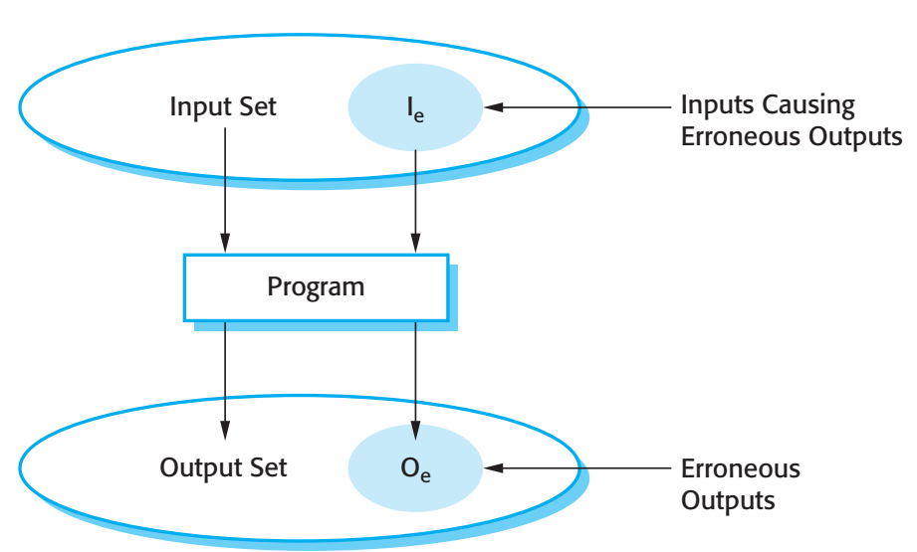
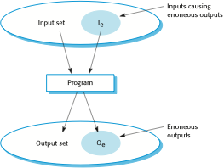
A system as an input/output mapping

Slide 28
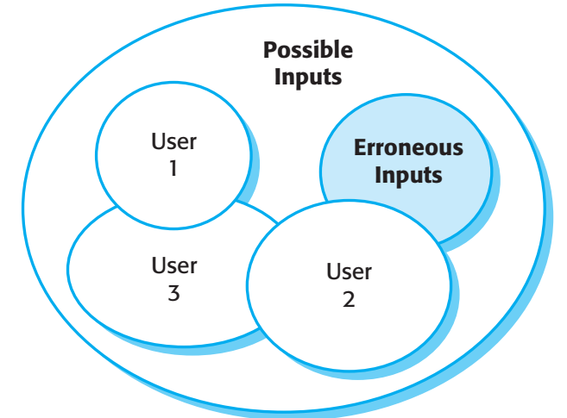
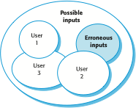
Software usage patterns

Slide 29
Reliability in use
Removing X% of the faults in a system will not necessarily improve the reliability by X%. A study at IBM showed that removing 60% of product defects resulted in a 3% improvement in reliability.
Program defects may be in rarely executed sections of the code so may never be encountered by users. Removing these does not affect the perceived reliability.
Users adapt their behaviour to avoid system features that may fail for them.
A program with known faults may therefore still be perceived as reliable by its users.

Slide 30
Reliability achievement
Fault avoidance
Development technique are used that either minimise the possibility of mistakes or trap mistakes before they result in the introduction of system faults.
Fault detection and removal
Verification and validation techniques that increase the probability of detecting and correcting errors before the system goes into service are used.
Fault tolerance
Run-time techniques are used to ensure that system faults do not result in system errors and/or that system errors do not lead to system failures.

Slide 31
Safety
Safety is a property of a system that reflects the system’s ability to operate, normally or abnormally, without danger of causing human injury or death and without damage to the system’s environment.
It is important to consider software safety as most devices whose failure is critical now incorporate software-based control systems.
Safety requirements are often exclusive requirements i.e. they exclude undesirable situations rather than specify required system services. These generate functional safety requirements.

Slide 32
Safety criticality
Primary safety-critical systems
Embedded software systems whose failure can cause the associated hardware to fail and directly threaten people. Example is the insulin pump control system.
Secondary safety-critical systems
Systems whose failure results in faults in other (socio-technical) systems, which can then have safety consequences. For example, the MHC-PMS is safety-critical as failure may lead to inappropriate treatment being prescribed.

Slide 33
Safety and reliability
Safety and reliability are related but distinct
In general, reliability and availability are necessary but not sufficient conditions for system safety
Reliability is concerned with conformance to a given specification and delivery of service
Safety is concerned with ensuring system cannot cause damage irrespective of whether or not it conforms to its specification

Slide 34
Unsafe reliable systems
There may be dormant faults in a system that are undetected for many years and only rarely arise.
Specification errors
If the system specification is incorrect then the system can behave as specified but still cause an accident.
Hardware failures generating spurious inputs
Hard to anticipate in the specification.
Context-sensitive commands i.e. issuing the right command at the wrong time
Often the result of operator error.

Slide 35
Safety terminology
Term | Definition
Accident (or mishap) | An unplanned event or sequence of events which results in human death or injury, damage to property, or to the environment. An overdose of insulin is an example of an accident.
Hazard | A condition with the potential for causing or contributing to an accident. A failure of the sensor that measures blood glucose is an example of a hazard.
Damage | A measure of the loss resulting from a mishap. Damage can range from many people being killed as a result of an accident to minor injury or property damage. Damage resulting from an overdose of insulin could be serious injury or the death of the user of the insulin pump.
Hazard severity | An assessment of the worst possible damage that could result from a particular hazard. Hazard severity can range from catastrophic, where many people are killed, to minor, where only minor damage results. When an individual death is a possibility, a reasonable assessment of hazard severity is ‘very high’.
Hazard probability | The probability of the events occurring which create a hazard. Probability values tend to be arbitrary but range from ‘probable’ (say 1/100 chance of a hazard occurring) to ‘implausible’ (no conceivable situations are likely in which the hazard could occur). The probability of a sensor failure in the insulin pump that results in an overdose is probably low.
Risk | This is a measure of the probability that the system will cause an accident. The risk is assessed by considering the hazard probability, the hazard severity, and the probability that the hazard will lead to an accident. The risk of an insulin overdose is probably medium to low.

Slide 36
Safety achievement
Hazard avoidance
The system is designed so that some classes of hazard simply cannot arise.
Hazard detection and removal
The system is designed so that hazards are detected and removed before they result in an accident.
Damage limitation
The system includes protection features that minimise the damage that may result from an accident.

Slide 37
Normal accidents
Accidents in complex systems rarely have a single cause as these systems are designed to be resilient to a single point of failure
Designing systems so that a single point of failure does not cause an accident is a fundamental principle of safe systems design.
Almost all accidents are a result of combinations of malfunctions rather than single failures.
It is probably the case that anticipating all problem combinations, especially, in software controlled systems is impossible so achieving complete safety is impossible. Accidents are inevitable.

Slide 38
Software safety benefits
Although software failures can be safety-critical, the use of software control systems contributes to increased system safety
Software monitoring and control allows a wider range of conditions to be monitored and controlled than is possible using electro-mechanical safety systems.
Software control allows safety strategies to be adopted that reduce the amount of time people spend in hazardous environments.
Software can detect and correct safety-critical operator errors.

Slide 39
Security
The security of a system is a system property that reflects the system’s ability to protect itself from accidental or deliberate external attack.
Security is essential as most systems are networked so that external access to the system through the Internet is possible.
Security is an essential pre-requisite for availability, reliability and safety.

Slide 40
Fundamental security
If a system is a networked system and is insecure then statements about its reliability and its safety are unreliable.
These statements depend on the executing system and the developed system being the same. However, intrusion can change the executing system and/or its data.
Therefore, the reliability and safety assurance is no longer valid.

Slide 41
Security terminology
Term | Definition
Asset | Something of value which has to be protected. The asset may be the software system itself or data used by that system.
Exposure | Possible loss or harm to a computing system. This can be loss or damage to data, or can be a loss of time and effort if recovery is necessary after a security breach.
Vulnerability | A weakness in a computer-based system that may be exploited to cause loss or harm.
Attack | An exploitation of a system’s vulnerability. Generally, this is from outside the system and is a deliberate attempt to cause some damage.
Threats | Circumstances that have potential to cause loss or harm. You can think of these as a system vulnerability that is subjected to an attack.
Control | A protective measure that reduces a system’s vulnerability. Encryption is an example of a control that reduces a vulnerability of a weak access control system

Slide 42
Examples of security terminology (MHC-PMS)
Term | Example
Asset | The records of each patient that is receiving or has received treatment.
Exposure | Potential financial loss from future patients who do not seek treatment because they do not trust the clinic to maintain their data. Financial loss from legal action by the sports star. Loss of reputation.
Vulnerability | A weak password system which makes it easy for users to set guessable passwords. User ids that are the same as names.
Attack | An impersonation of an authorized user.
Threat | An unauthorized user will gain access to the system by guessing the credentials (login name and password) of an authorized user.
Control | A password checking system that disallows user passwords that are proper names or words that are normally included in a dictionary.

Slide 43
Threat classes
Threats to the confidentiality of the system and its data
Can disclose information to people or programs that do not have authorization to access that information.
Threats to the integrity of the system and its data
Can damage or corrupt the software or its data.
Threats to the availability of the system and its data
Can restrict access to the system and data for authorized users.

Slide 44
Damage from insecurity
Denial of service
The system is forced into a state where normal services are unavailable or where service provision is significantly degraded
Corruption of programs or data
The programs or data in the system may be modified in an unauthorised way
Disclosure of confidential information
Information that is managed by the system may be exposed to people who are not authorised to read or use that information

Slide 45
Security assurance
Vulnerability avoidance
The system is designed so that vulnerabilities do not occur. For example, if there is no external network connection then external attack is impossible
Attack detection and elimination
The system is designed so that attacks on vulnerabilities are detected and neutralised before they result in an exposure. For example, virus checkers find and remove viruses before they infect a system
Exposure limitation and recovery
The system is designed so that the adverse consequences of a successful attack are minimised. For example, a backup policy allows damaged information to be restored

Slide 46
Key points
Reliability is related to the probability of an error occurring in operational use. A system with known faults may be reliable.
Safety is a system attribute that reflects the system’s ability to operate without threatening people or the environment.
Security is a system attribute that reflects the system’s ability to protect itself from external attack.
Dependability is compromised if a system is insecure as the code or data may be corrupted.

